Slide 1
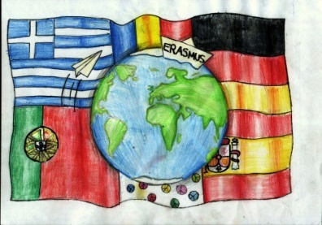
Odyssey- Migration and its Influence on Teens

Slide 2
Gymnasium Neue Oberschule , Braunschweig,Germany
3rd Gymnasio of Kalamata Kalamata, Greece
EBI Francisco Ferreira Drummond, Terceira Portugal
Colegiul Economic Buzău , Romania
IES Luis Seoane, Pontevedra, Spain
"This presentation has been prepared exclusively for educational purposes under the Creative Commons Attribution (Attribution, Share Alike) . No infringement is intended. It is the outcome of a student project, and does not necessarily represent the views of the 3 Gymnasio of Kalamata or any other individuals referenced or acknowledged within the presentation.

Slide 3
CARTOONS
These are the final cartoons we selected to present in Romania. Some were not only presented in Greek newspapers.

Slide 4
A Migrant’s hope or reality?

Slide 5
A Migrant’s hope or reality?
Here we see man who is homeless. He is all the migrants that come to Europe with dreams of hope, seeking help but in the end the Eurhope is that they end up homeless .Eurhope being a play on the words Europe and hope, with the “h” not pronounced

Slide 6
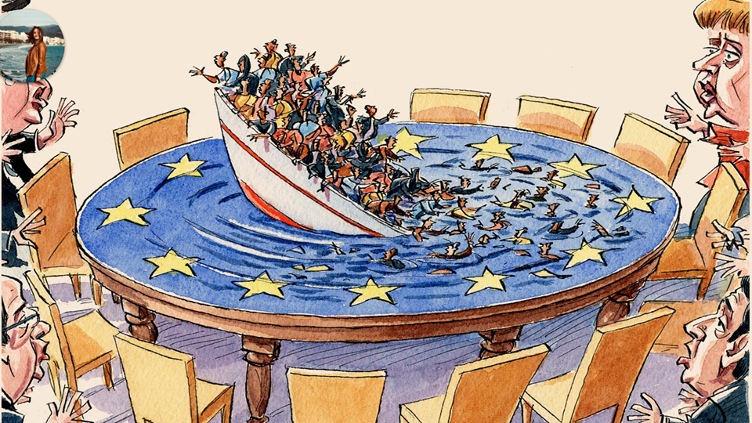
European Empathy

Slide 7
European Empathy
In the second picture we see the powerful leaders of Europe standing around the table where a ship full of migrants is sinking. The leaders all look horrified but they're still standing around raising their hands in despair but doing nothing to actually help the people.

Slide 8
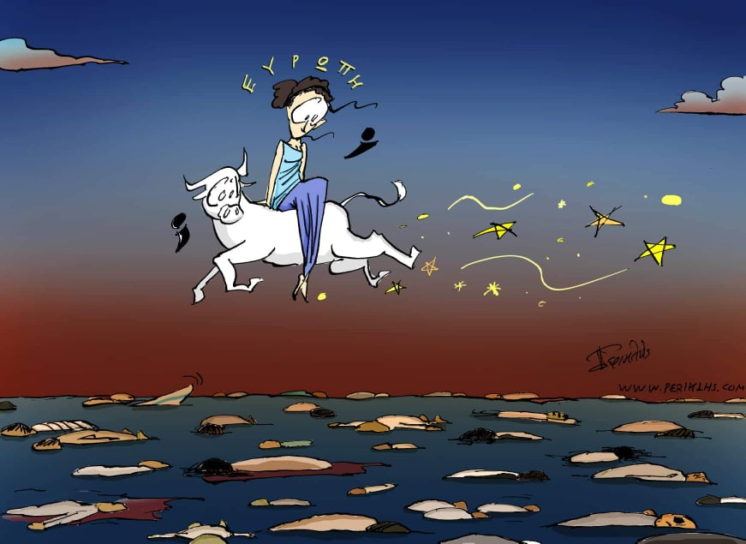
Europa and the Bull nowadays

Slide 9
Europa and the Bull nowadays
The third picture originates from Greek mythology. It shows Zeus, God of hospitality as a white bull with Europa, a Phoenician princess on its back flying over the Mediterranean Sea. He is bringing the princess to the land of Crete from her homelands in the middle east. The name Europe comes from the princess. As the bull flies over the sea both it and Europa are shocked at the bodies that they see flowing in the Mediterranean. They are the bodies of migrants that have also been trying to get to Europe. It is ironic because Phoenicia included a part of today’s Syria. So the princess and the God of hospitality came here to Europe thousands of years ago but today we turn these people away.

Slide 10
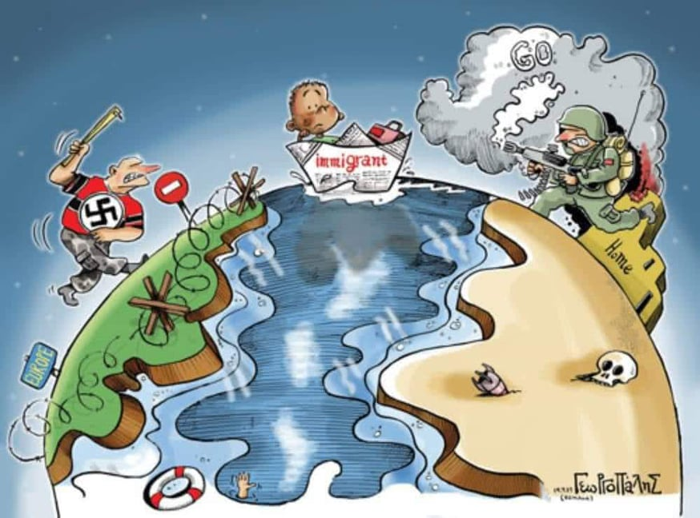
It’s a matter of choice

Slide 11
It’s a matter of choice
In the fourth picture we see the east and west side of the Earth. On the east side representing the Middle East there are wars going on and people are dying while on the west side there is a fascist who is has put up some barbed wire and is holding a club ready to beat someone. He's actually trying to keep out the migrant who is in a boat trying to get to that side. The migrant looks confused because he can't go back but he can't move forward. He knows his boat will sink (it’s made of paper). At the bottom of the picture we see a hand representing all the people who have died in the Mediterranean while trying to cross into Europe- a safer place.

Slide 12
Nice Doggie!

Slide 13
Nice Doggie!
In the fifth picture we see a woman with the EU flag holding a dog called Islamophobia. The dog is called to Islamophobia and is wearing a swastika on its collar. Europe is telling the Muslim family who are fearful of the growling dog that they shouldn't be afraid because its growling only represents freedom of speech but the dog is ready to charge at them and hurt them

Slide 14
Time is of the matter

Slide 15
Time is of the matter
In the last picture there is an hourglass. In the top part of the hourglass we see a lot of immigrants trying to fall through to get to the bottom piece which is a beach probably in Italy or Greece. In the middle there is a man using a belt to actually make the hourglass tighter and tighter so that very few people can go through. He's surrounded by the EU flag stars. Finally, we see that those who get through die or are miserable with little hopes of a better future. ( we can see the dead baby and the little girl sad and crying)

