Slide 1
MIGRATION IN THE PAST
Greece : 1950 - 2000

Slide 2
Gymnasium Neue Oberschule , Braunschweig,Germany
3rd Gymnasio of Kalamata Kalamata, Greece
EBI Francisco Ferreira Drummond, Terceira Portugal
Colegiul Economic Buzău , Romania
IES Luis Seoane, Pontevedra, Spain
"This presentation has been prepared exclusively for educational purposes under the Creative Commons Attribution (Attribution, Share Alike) . No infringement is intended. It is the outcome of a student project, and does not necessarily represent the views of the 3 Gymnasio of Kalamata or any other individuals referenced or acknowledged within the presentation.

Slide 3
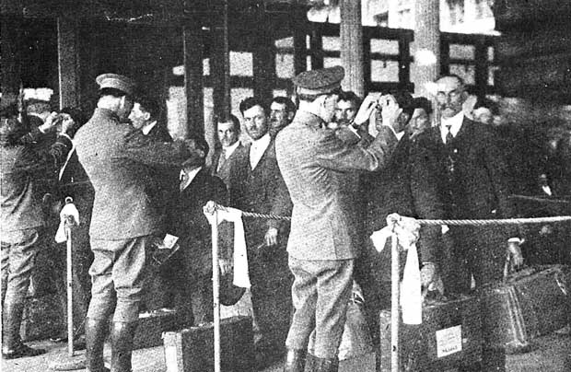
INTRODUCTION
Migration of people is not a new phenomenon. From the past, groups of people were forced to move to from one country or place to another, in order to survive because of economical, social, political or environmental problems. A characteristic example is the huge flow of immigration in the 20th century, as a consequence of the two world wars.

Slide 4
2nd World War {1939-1945}
The second World War forced a lot of people move to United States, Canada and later on, Germany, to find work and begin a new life.
As for Greece, the second World War and the Civil War that followed, left the country bleeding since unemployment, poverty and social insecurity dominated that time.
A Greek Historian who studied the Greek migration to Germany, George Matzouranis, describes the situation in Greece after the end of the civil war.

Slide 5
George Moutzouranis’ words about Greece
George Matzouranis describes the terrible situation in Greece some years after the end of the Civil War.

Slide 6
Greek migration in the 20th century
Between 1950-1960, unemployment created an enormous flow of immigrants who headed to:
America
Australia
European countries (Belgium, Germany)
1961-1973
Emigration to West Germany, Belgium and Australia. After 1974 there is a decline of immigration while the number of people who return to their countries increases. Also, the invasion of the Turks forced a lot of Greek Cyprians to move to Australia and The United Kingdom
312.000
965.000

Slide 7
1967-1973
A special note should be made for the period of 1967-1974 when the military junta rule was in charge of the country. During this period many prominent Greeks such as Odysseas Elytis, Mikis Theodorakis Melina Mercouri and many others were self exiled because of their political beliefs and their opposition to the junta

Slide 8
Causes of Greek emigration
Terrible life conditions
Extensive unemployment
Tragic economical situation of the post-war Greece
The countries which hosted the immigrants (West Germany) favored immigration from Italy Greece and Yugoslavia because of the same western culture
Host countries wanted cheap working hands

Slide 10
Geographic Allocation of Greek immigrants
1%
23%
13%
61%
1%

Slide 11
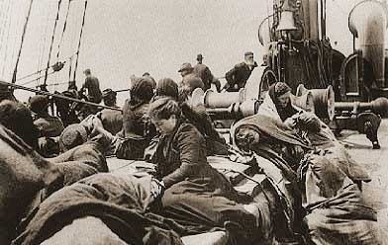
Situations Greek people faced in their new countries
In America, Australia, Germany and the other countries that accepted Greek immigrants during the period of crisis, immigrants were usually accused of criminal and illegal actions and disobedience to the law which was not true. But, Greek people, in search of work and safety, easily accepted the new situation. As the years passed, Greek people adjusted to their new life and were assimilated into their new country. Many kept their traditions and beliefs and sometimes helped to
incorporate them into the culture of the new
country

Slide 12
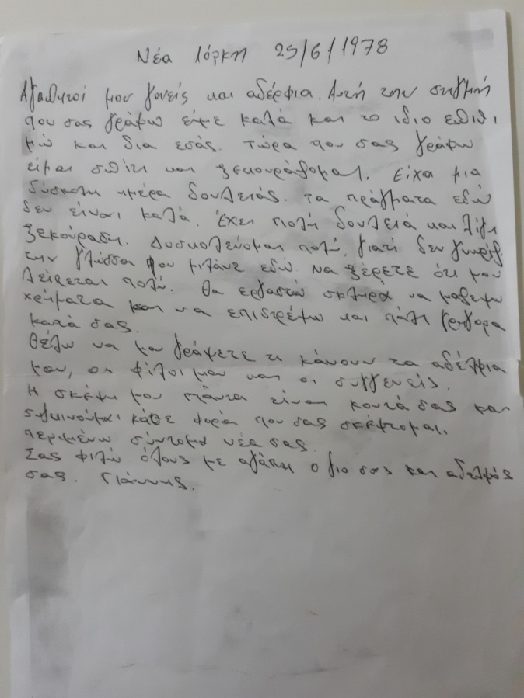
Immigrants’ testimonies
New York, 25/6/1978
Dear parents, brothers, and sisters,
At this moment that I’m writing to you, I’m well and I hope the same for you. I’m home and I’m resting now . I had a difficult day at work. Things here, are not good. There is a lot of work and a little rest. I’m having a hard time because I don’t know the language here. I want you to know that I miss you so much. I am going to work hard to raise some money and return to you.
I want you to write me how my brothers, my friends and relatives are doing. I think about you all the time. I’m looking forward to hearing about you.
I’m sending kisses to all of you, I love you. Your son and brother, Giannis.

Slide 14
Characteristic description of a Greek woman worker in Netherlands in 1960

Slide 15
"When I came to work at Philips, my eyes were really sharp! And because I had such great eyes, the boss assigned all the fine work to me, I never moved to another post. For ten years I sat, bending over those little shiny parts and choosing them. There were two of us . If we made together 15,000 pieces a day, I made the 11,000. So you understand! The other woman changed posts quickly, but they left me there. Many times I asked them to give me another job, because I was tired of doing the same thing over and over again. But the boss told me. No, we won’t change you under any circumstances. You make 11,000 pieces. You are our best worker. And when I last saw him and told him I was almost blind in both eyes, he told me. Really what are you saying girl? I did not expect to lose such a great worker ... "

Slide 16
Famous Greek immigrants
Melina Merkouri
Anastasios Stathopoulos
Cornelius Kastoriadis
Eleni Glykatzi-Arveler

Slide 17
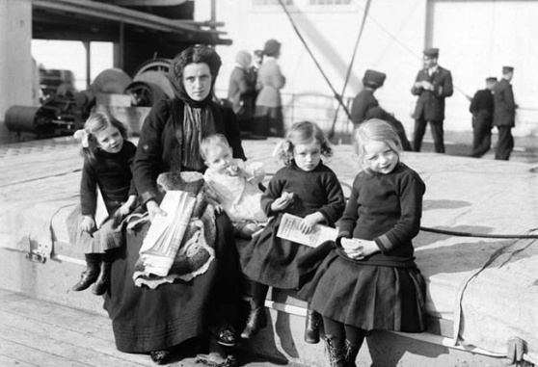
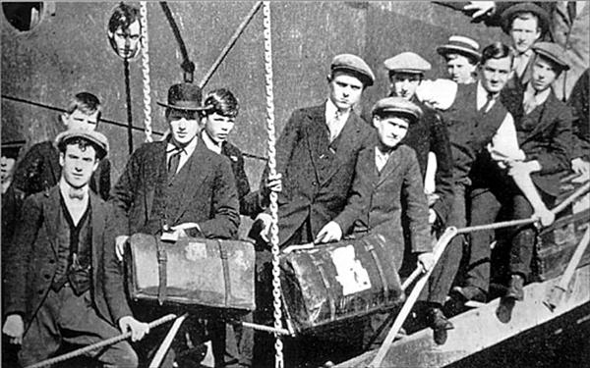
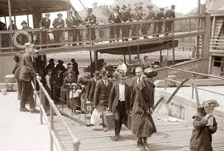
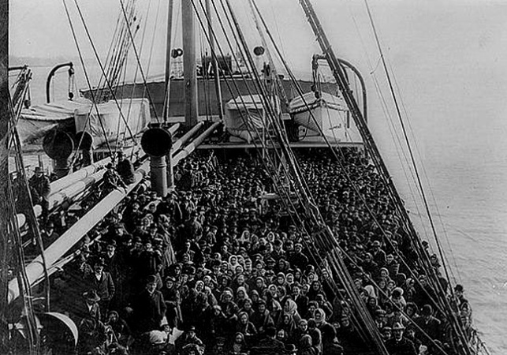
Pictures

Slide 18
~End of presentation~
Thank you very much!

