Slide 1
Migration in Greece
Thousands of immigrants and refugees enter our
country each year,like the thousands of people that leave Greece. Immigration affects our nation on multiple levels from economy to culture and shapes our lifestyle.

Slide 2
Statistics and information
Most refugees and immigrants that come Greece are from third world countries. Syria, Iraq, Afghanistan, Pakistan and the Balkan region.
Many of these people are underage and without guardians.
Most people who seek asylum in Greece are between 18 and 34 years old.
It has been noted that the number of male refugees / immigrants is significantly larger than that of the female ones.

Slide 3
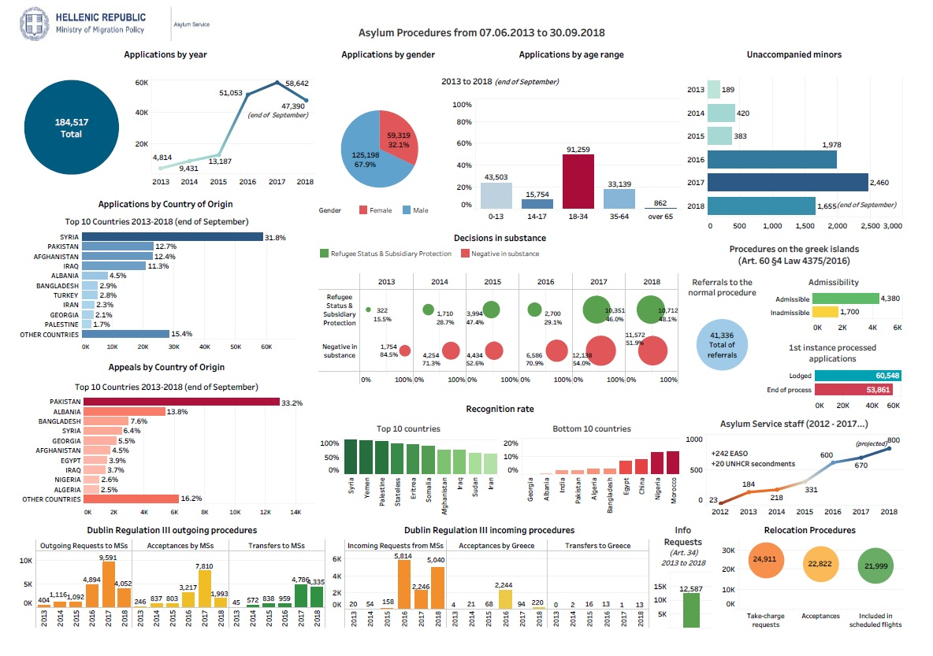

Slide 4
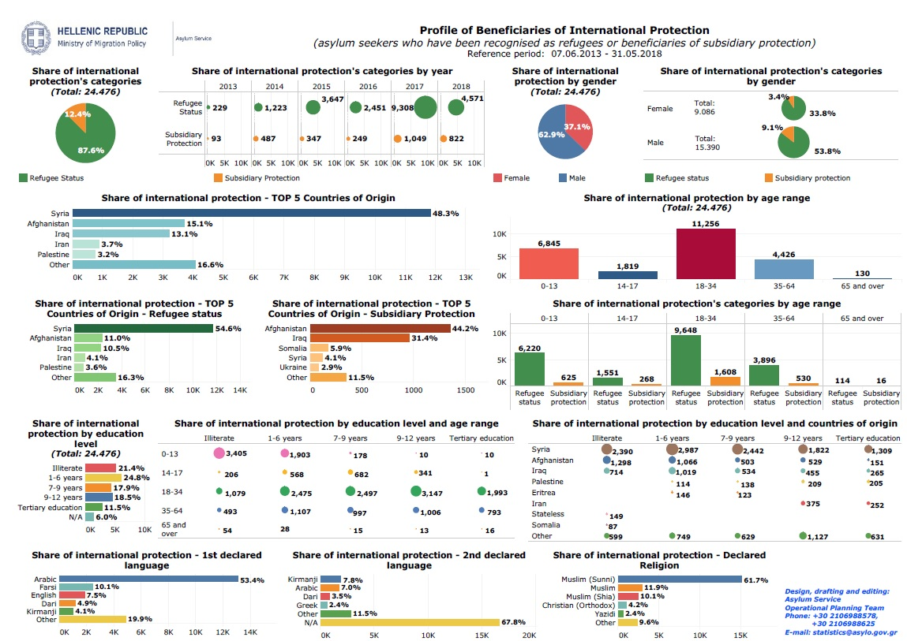

Slide 5
The 1st stage
When they first arrive to Greece, immigrants have to submit an application in order to obtain international protection (asylum)
Who can obtain the asylum :
People who are persecuted in their countries due their race and/or religion or are facing the death penalty.
People who have to leave their countries for political reasons or are in any danger if they stay in their homeland.
Individuals who were the target of abuse due to their charactiristics

Slide 6
Where they apply:
Regional Asylum offices and units
How
Applications are free of charge and anyone has the right to submit one. You have have to apply by going to the regional office yourself. One can also apply for their family members should they also need asylum. You have to hand in your travel documents or any other document you may have in your possesion and is relevant to the examination of your application, the verification of your and your family’s identity, your country and place of origin, as well as your family status.

Slide 7
Attention
If you are under 18 and over 15 years old, you can apply for yourself, even though you are considered underage.
If you are under 15 years old, the application has to be done by your adult representative, who is appointed by the court.
You will be interviewed, fingerprinted (fingerprint verification only applies to individuals 14 and over) and photos of you and your family members will be taken.
You can book an appointment regarding the time and date you have to go to the office and register your application, as well as be interviewed.

Slide 8
In case you don’t speak Greek, a language interpreter will be present at your interview.
If you need a lawyer, you have to cover the expenses on your own, unless you are a minor and under 15. In that case, the government will provide you with one to accompany you at your interview, if needed.
You have to answer questions in complete truthfulness, since giving false data will affect the chances of your acquiring asylum.
For more detailed information, you may visit the official “Hellenic Republic : Ministry of migration policy” website here

